Slide 1
Capstone Project
Battle of Neighborhoods
Korean Restaurant in NYC

Slide 2
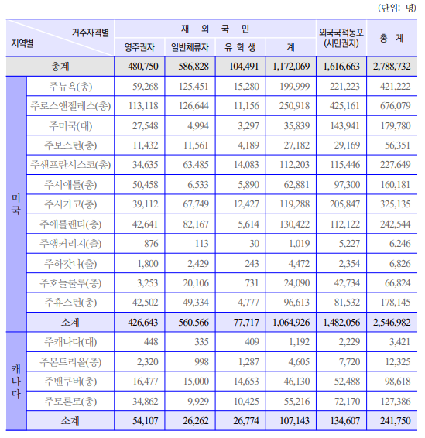
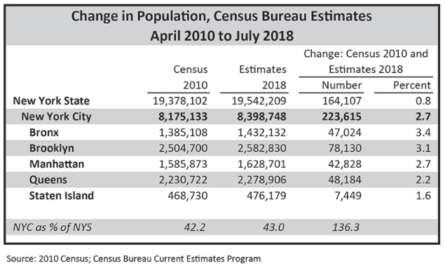
Problem & Background
Following Korea Ministry of Foreign Affairs, as of 2019, there are 2.54 million Koreans living in the United States and about 420,000 Koreans living in New York. This is 2nd largest population after LA
In New York, where 8.4 million people live, the proportion of Koreans is about 4.2%
Source: http://www.mofa.go.kr/www/wpge/m_21507/contents.do

Slide 3

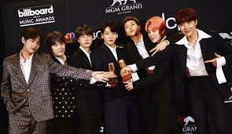
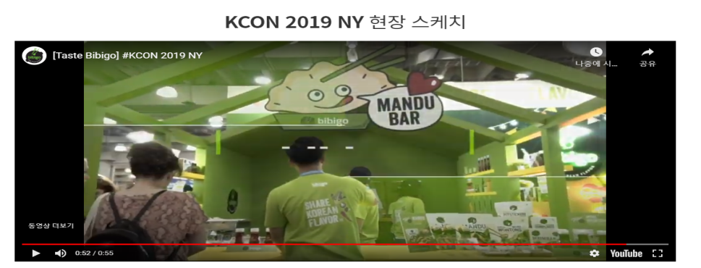
Problem & Background
Recently, the interest in Korean culture in American society has been increasing as we have seen Korean pop such as Psy and BTS and Korean dramas.
The purpose of this project is to analyze and visualize information about Korean restaurants to New Yorkers and tourists to provide the following information to citizens and tourists who interested in Korean food.
Source: https://www.bbc.com/news/technology-20483087
Source: http://economychosun.com/client/news/view.php?boardName=C03&t_num=13607013
https://www.cj.co.kr/kr/k-food-life/moment-story/25

Slide 4
Data and Methodology
https://cocl.us/new_york_dataset for use data source(list of boroughs, neighbourghoods and geographical) from NYC
Foursquare API for information of Korean restaurants
The visualization of the neighborhoods will be achieved using folium library with Python.
The data analysis and results will be done with Python programming using the Jupyter Notebook platform.

Slide 5
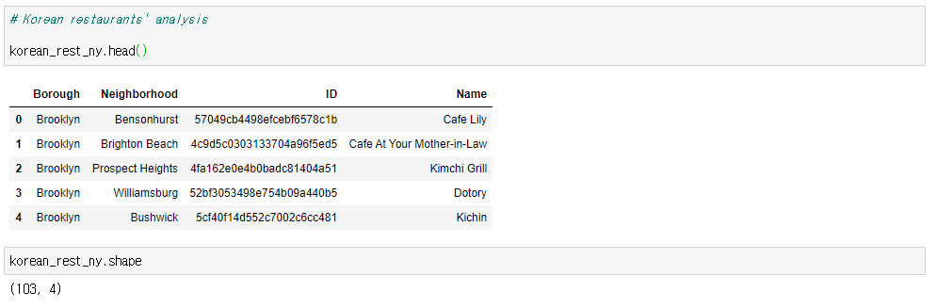
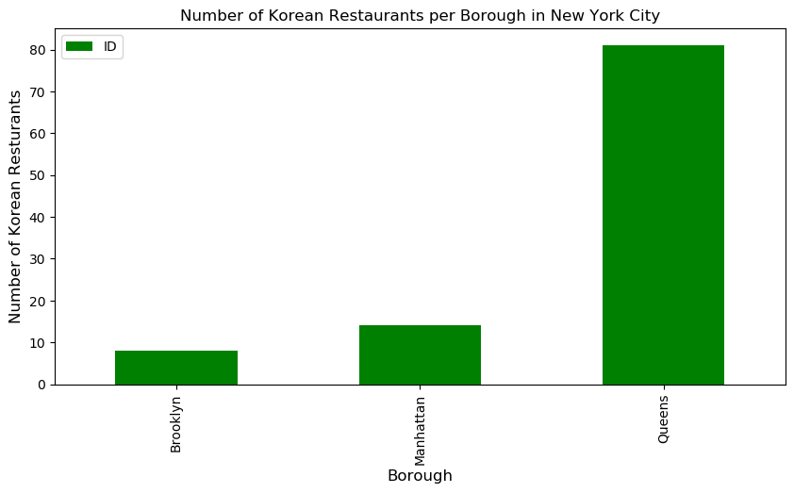
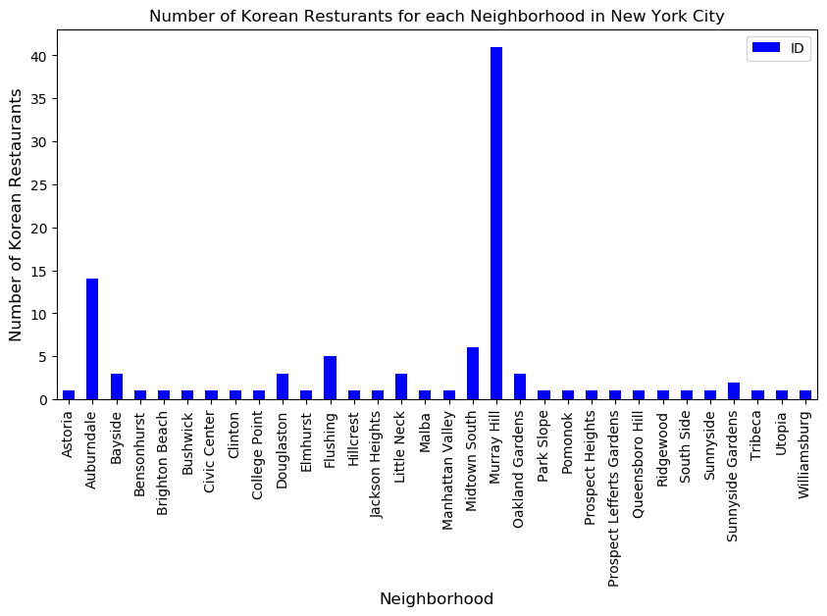
Korean restaurants in NYC
There are 103 Korean restaurants in NYC
Over 80% are located in Queens and around 40 located in Murray Hill

Slide 6
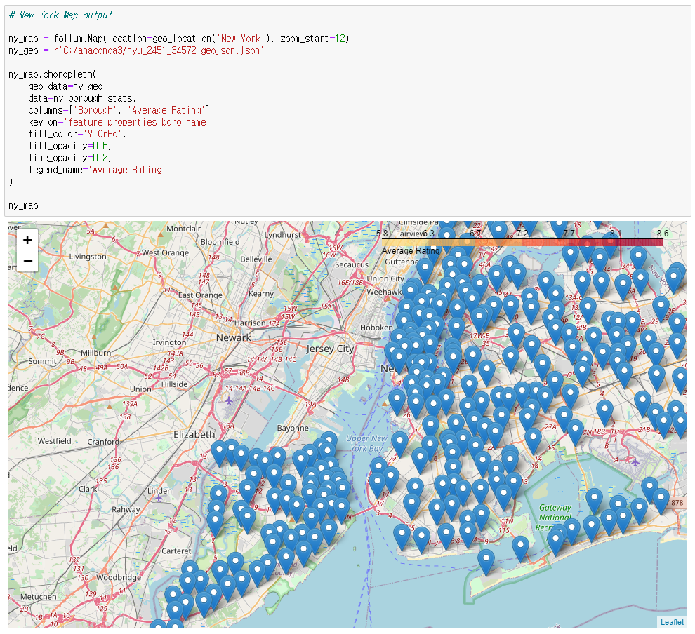
Korean restaurants in NYC

Slide 7
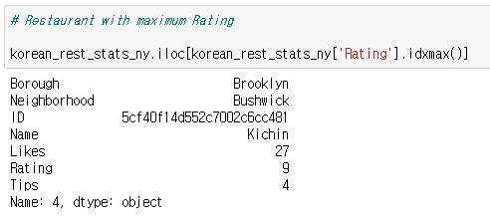
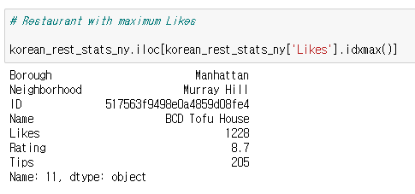
Best Korean restaurants in NYC
The best rating restaurant is Kinchin Bushwick, Brooklyn
The best likes restaurant is BCD Tofu House Murray Hill, Manhattan

Slide 8
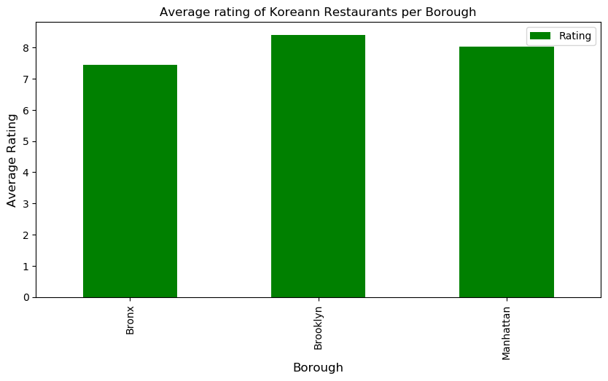
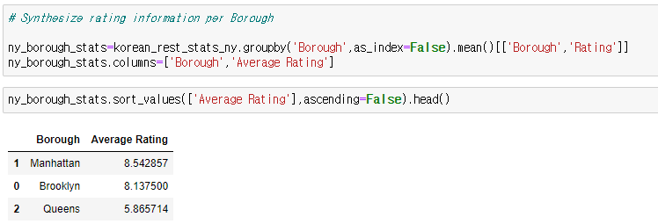
Rating Korean restaurants in NYC
The best rating restaurant in borough is Manhattan in Avg rataing 8.54
The best rating restaurant in neighborhoods is Murray Hill, Manhattan
The lowest rating restaurant in borough is Queens in Avg rating 5.86

Slide 9
Summary and conclusion
The objectives of the projects include the visualization and analysis Korean restaurants in New York City
There are 103 Korean restaurants in New York City. About 80% of these restaurants are located in Queens. This is considered to be related to most Koreans living in New York, Queens. There are many Korean restaurants in Queens Park, but the highest rated restaurant was Kichin in Bushwik, Brooklyn and BCD Tofu House in Murray Hill, Manhattan.
There are two Murray Hill in NYC, Manhattan and Queens. The regional rating of Murry Hill is very high with 8.8 points, but this is Murry Hill in Manhattan.
Queens has many Korean restaurants, but has a low rating of 5.8.
This is likely to be a very frustrating meal if New Yorkers and tourists misunderstand it as a restaurant in Murry Hill, Queens, where many Koreans live. As a result, your chances of lowering your interest in Korean food are very high. In order to use it as a K-food guide, you have to be aware that it is Murry Hill in Manhattan.

